Slide 1



TensorFlow Lite - Running Machine Learning Models on Android&Embedded devices
Deploy machine learning models on mobile and IoT devices
Dinakar Maurya

Slide 2
Table of Contents
What, Why, How
Some Basic Terms
Python Setup & Generate Tensorflow lite file(.lite)
Android Studio Setup
How does it work - Android Code
Questions

Slide 3
What, Why, How

Slide 4
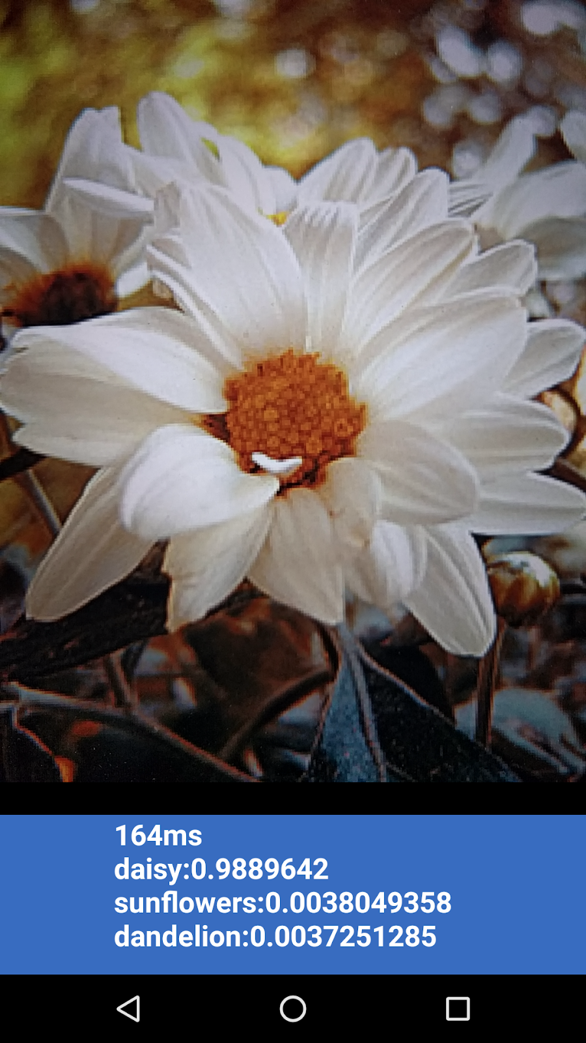
Build your first TensorFlow Lite app
What you will build
A simple android camera app that runs a TensorFlow image recognition program to identify flowers.
Detect Images

Slide 5





Scope - Optimized models for common mobile
and edge use cases
Image classification
Identify hundreds of objects, including people, activities, animals, plants, and places.
Object detection
Detect multiple objects with bounding boxes. Yes, dogs and cats too.
Smart reply
Generate reply suggestions to input conversational chat messages.
Pose estimation
Estimate poses for single or multiple people. Imagine the possibilities,
including stick figure dance parties.
Segmentation
Pinpoint the shape of objects with strict localization accuracy and semantic labels.
Trained with people, places, animals, and more.

Slide 6

What is TensorFlow & TensorFlow Lite
Tensorflow Dveloped by the Google Brain team for internal Google use. It was released under the Apache 2.0 open-source license on November 9, 2015

Slide 7
What is TensorFlow & TensorFlow Lite
TensorFlow
TensorFlow is an open-source software library for dataflow and differentiable programming across a range of tasks.
It is a symbolic math library, and is also used for machine learning applications such as neural networks.
TensorFlow is a multipurpose machine learning framework.
TensorFlow can be used anywhere from training huge models across clusters in the cloud, to running models locally on an embedded system like your phone.
TensorFlow Lite
TensorFlow Lite is for mobile and embedded devices.
TensorFlow Lite is the official solution for running machine learning models on mobile and embedded devices.
It enables on‑device machine learning inference with low latency and a small binary size on Android, iOS, and other operating systems.

Slide 8
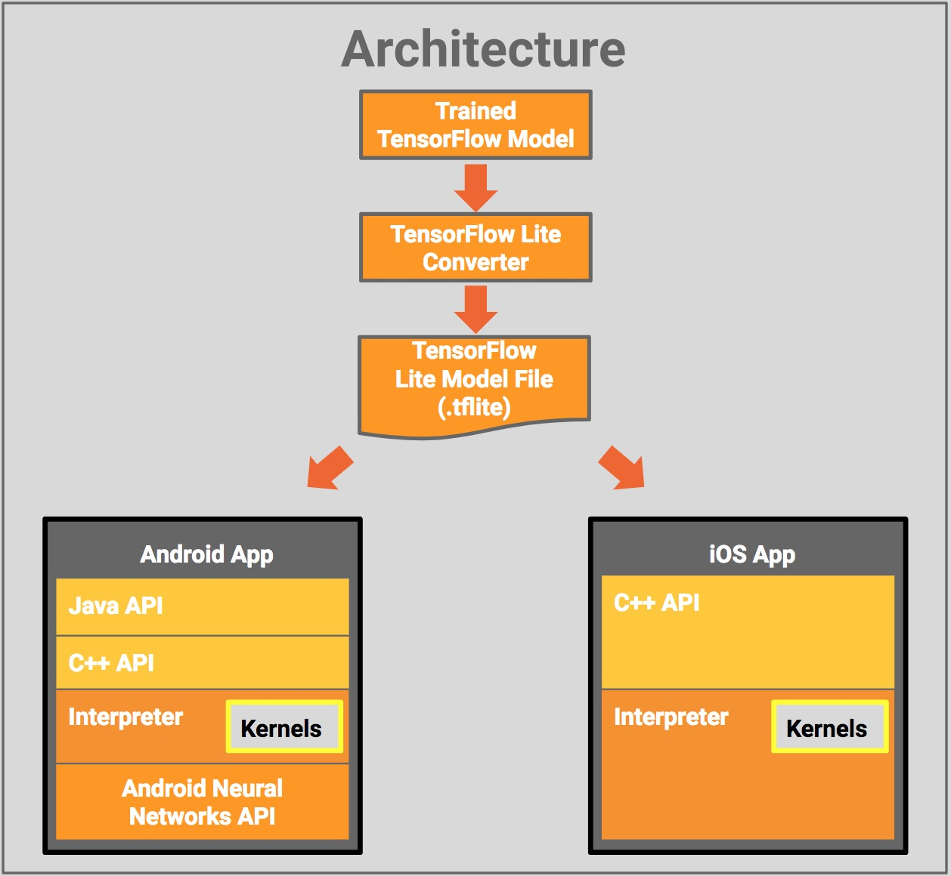
TensorFlow Lite Architecture

Slide 9
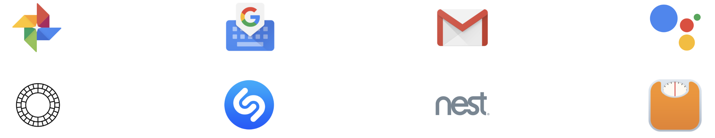
TensorFlow Lite Users
Use AI in Mobile Devices and Embedded Devices.
Enables on‑device machine learning inference with low latency and a small binary size on Android, iOS, and other operating systems.
Some of tensorFlow Lite users -

Slide 10
TensorFlow Lite example apps
Gesture recognition
Train a neural network to recognize gestures caught on your webcam using TensorFlow.js,
then use TensorFlow Lite to convert the model to run inference on your device.
Image classification
Test an image classification solution with a pre-trained model that can recognize 1000 different types of items from input frames on a mobile camera.
Object detection
Explore an app using a pre-trained model that draws and labels bounding boxes around 1000 different recognizable objects from input frames on a mobile camera.
Speech recognition
Explore an app that uses a microphone to spot keywords and return a probability score for the words spoken.

Slide 11
Benifits
On-device ML inference is difficult because of the many constraints—TensorFlow Lite can solve these:
Performance
TF Lite is fast with no noticeable accuracy loss.
Portability
Android, iOS, and more specialized IoT devices.
Low latency
Optimized float- and fixed-point CPU kernels.
Acceleration
Integration with GPU and internal/external accelerators.
TensorFlow Lite also supports hardware acceleration with the Android Neural Networks API.
Small model size
Controlled dependencies, quantization and op registration.
Tooling
Conversion, compression, benchmarking, power-consumption, and more.

Slide 12




How it works
Pick a model
Pick a new model or retrain an existing one.
Convert
Convert a TensorFlow model into a compressed flat buffer with the TensorFlow Lite Converter.
Deploy
Take the compressed .tflite file and load it into a mobile or embedded device.
Optimize
Quantize by converting 32-bit floats to more efficient 8-bit integers or run on GPU.

Slide 13
Some Basic Terms

Slide 14
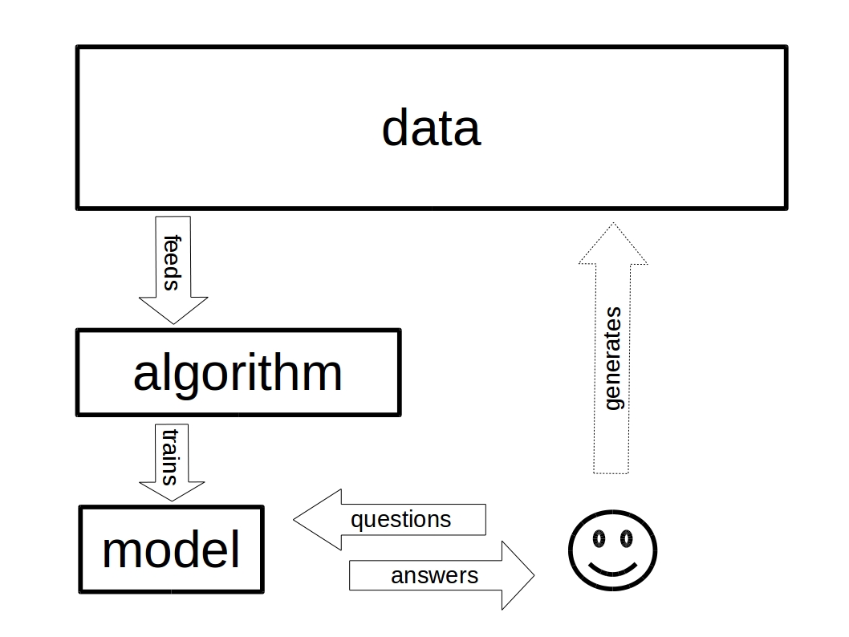

Before Starting - Some basic terms
Machine Learning
Machine Learning Classifiers

Slide 15
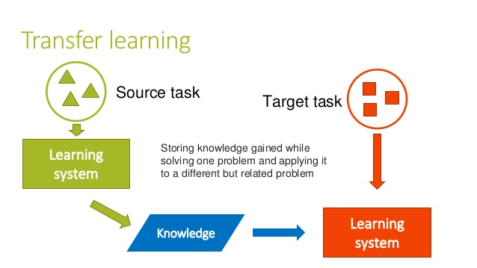
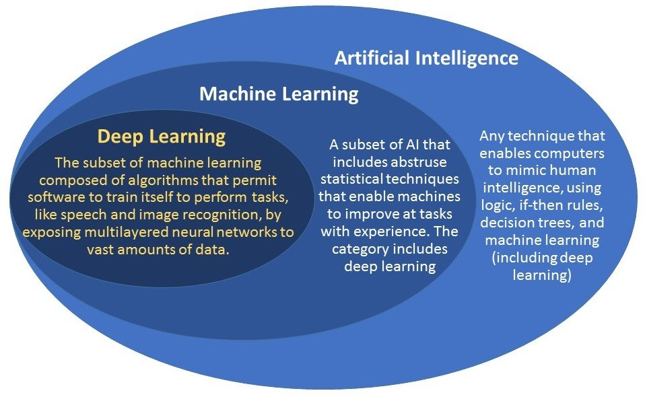
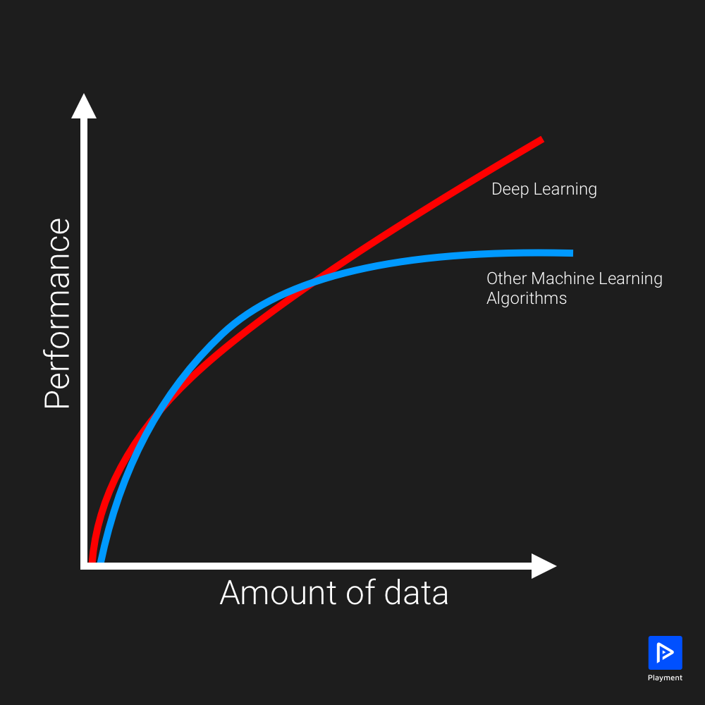
Before Starting - Some basic terms

Slide 16
Before Starting - Some basic terms
Transfer learning
Transfer learning is a research problem in machine learning that focuses on storing knowledge gained while solving one problem and applying it to a different but related problem.
For example, knowledge gained while learning to recognize cars could apply when trying to recognize trucks.
Pre-trained model(https://www.tensorflow.org/lite/guide/hosted_models)
A pre-trained model is a model that was trained on a large benchmark dataset to solve a problem similar to the one that we want to solve.
Models-
Inception v3 - 1000 classes - image dataset
It is trained for the ImageNet Large Visual Recognition Challenge using the data from 2012. This is a standard task in computer vision, where models try to classify entire images into 1000 classes.
MobileNet - A class of convolutional neural network designed by researchers at Google. They are coined “mobile-first” in that they’re architected from the ground up to be resource-friendly and run quickly, right on your phone.
PILLOW- Python Imaging Library is a free library for the Python programming language that adds support for opening, manipulating, and saving many different image file formats. It is available for Windows, Mac OS X and Linux.

Slide 17
Deep Learning Models - pre trained
Object detection
- coco_ssd_mobilenet_v1_1.0_quant_2018_06_29 - Recognize 80 different classes of objects
Pose estimation
-multi_person_mobilenet_v1_075_float - 16 poses (nose -1, leftEye - 2, rightEye - 3 etc.)
Image segmentation
- deeplabv3_257_mv_gpu
Smart reply
- smartreply_1.0_2017_11_01
Example of one mode size accuracy etc.
Model name | Paper and model | Model size | Top-1 accuracy | Top-5 accuracy | TF Lite performance
Inception_V3_quant | paper,tflite&pb | 23 Mb | 77.5% | 93.7% | 637 ms

Slide 18
Before Starting - Some basic terms
Model
A machine learning model can be a mathematical representation of a real-world process.
The output of the training process is a machine learning model which you can then use to make predictions.
Train
The training data is used to make sure the machine recognizes patterns in the data.
The cross-validation data is used to ensure better accuracy and efficiency of the algorithm used to train the machine.
And the test data is used to see how well the machine can predict new answers based on its training.
Classifier(Machine Learning Classifiers)
Classification is the process of predicting the class of given data points. Classes are sometimes called as targets/ labels or categories.
Classification predictive modeling is the task of approximating a mapping function (f) from input variables (X) to discrete output variables (y).
Linear Classifiers: Logistic Regression, Naive Bayes Classifier.
Support Vector Machines.
Decision Trees.
Boosted Trees.
Random Forest.
Neural Networks.
Nearest Neighbor.
Protocol Buffers(.pb) also known as protobuf, is Google's language-neutral, platform-neutral, extensible mechanism that is used to serialize structured data.
.tflite(Tensorflow Lite FlatBuffer File) -
Converted form of machine learning trained model.
This(.tflite file) gets loaded in to a mobile interpreter.

Slide 19
Python Setup & Generate Tensorflow lite file(.lite)

Slide 20

We build .lite and .txt files
.lite - describing the models
.txt file - describing the lables at the models trained for.
Example of .txt label file -
camellia
canna lily
canterbury bells
cape flower
carnation
cautleya spicata
clematis
colt s foot
columbine
common dandelion
corn poppy
cyclamen
daffodil
daisy
dandelion
desert rose
daisy - example of label

Slide 21
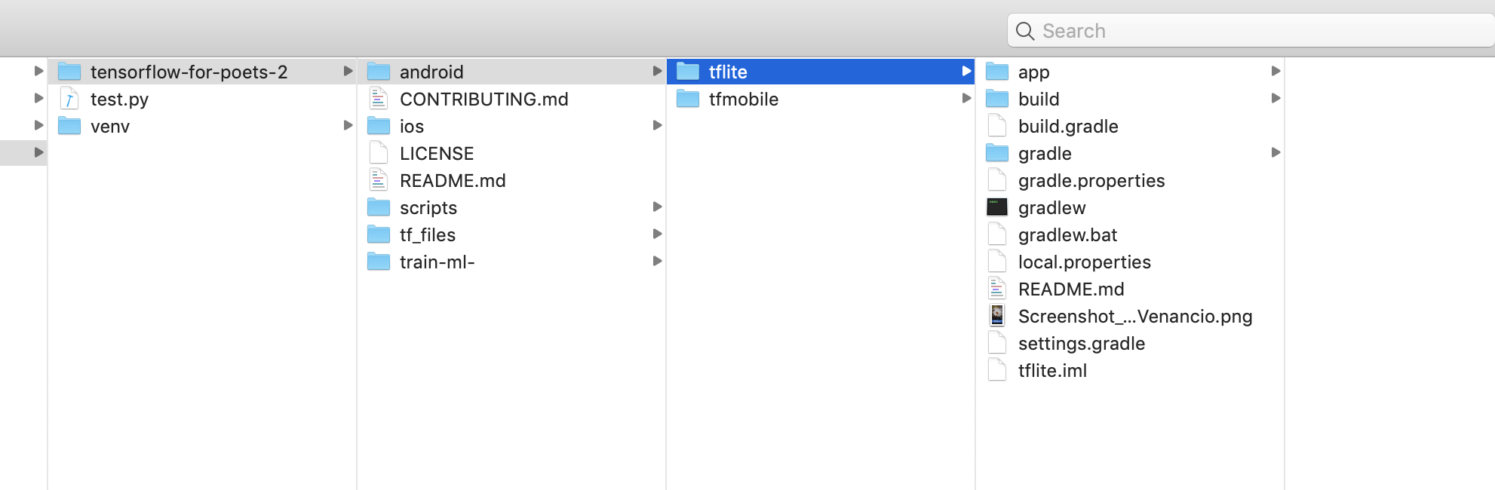
Setup Tensorflow
Steps-
pip install --upgrade "tensorflow==1.7.*"
pip install PILLOW
git clone https://github.com/googlecodelabs/tensorflow-for-poets-2
cd tensorflow-for-poets-2
git checkout end_of_first_codelab
ls tf_files

Slide 22

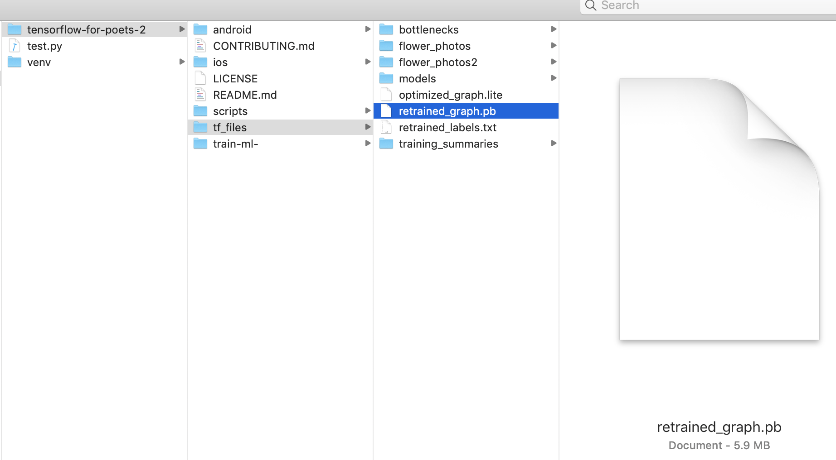
Test the Model
The scripts/ directory contains a simple command line script, label_image.py to test the network.
Now we'll test label_image.py on this picture of some daisies:
flower_photos/daisy/3475870145_685a19116d.jpg

Slide 23
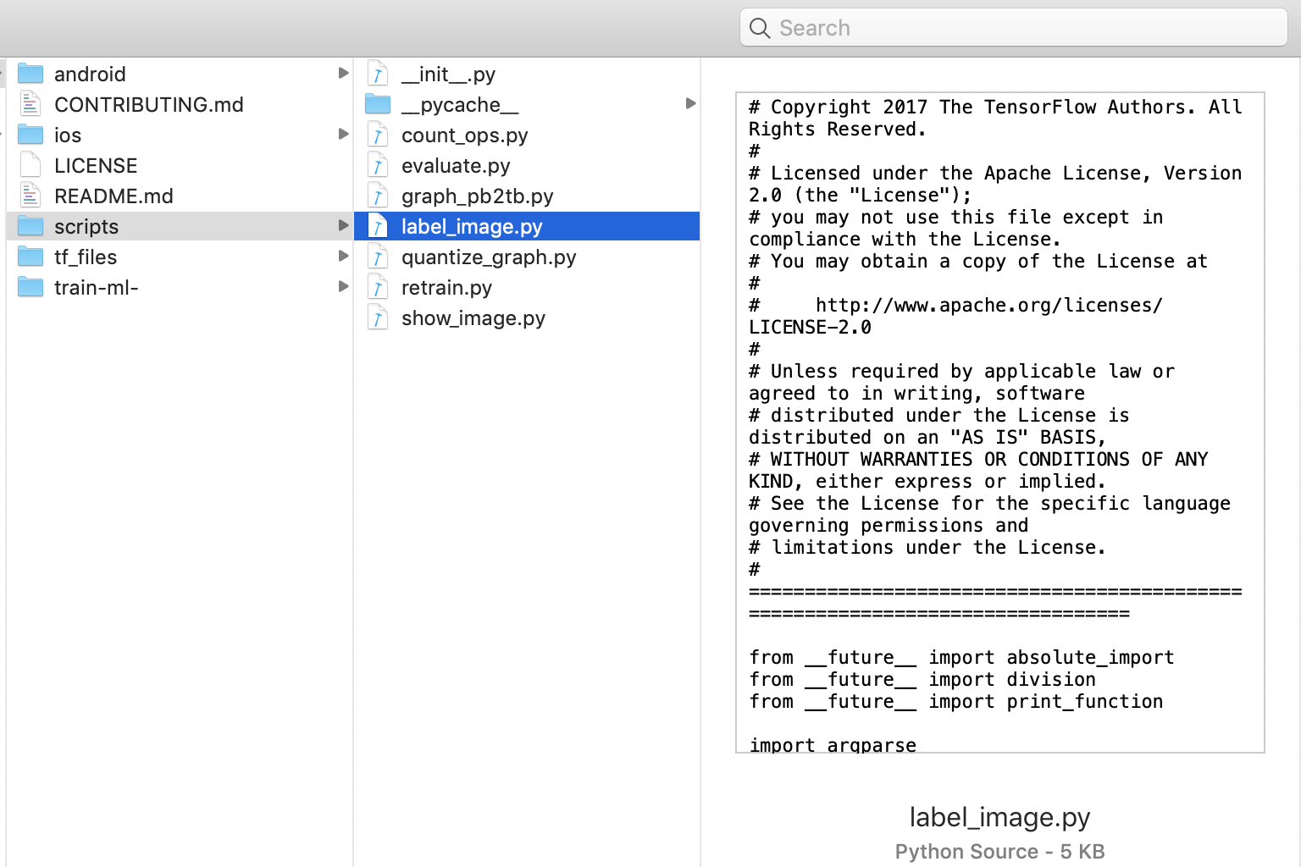
Test the Model
python -m scripts.label_image \ --graph=tf_files/retrained_graph.pb \ --image=tf_files/flower_photos/daisy/3475870145_685a19116d.jpg
The script will print the probability the model has assigned to each flower type.
Something like this:
Evaluation time (1-image): 0.140s daisy 0.7361 dandelion 0.242222 tulips 0.0185161 roses 0.0031544 sunflowers 8.00981e-06
This should hopefully produce a sensible top label for your example.
You'll be using this command to make sure you're still getting sensible results
as you do further processing on the model file to prepare it for use in a mobile app.

Slide 24
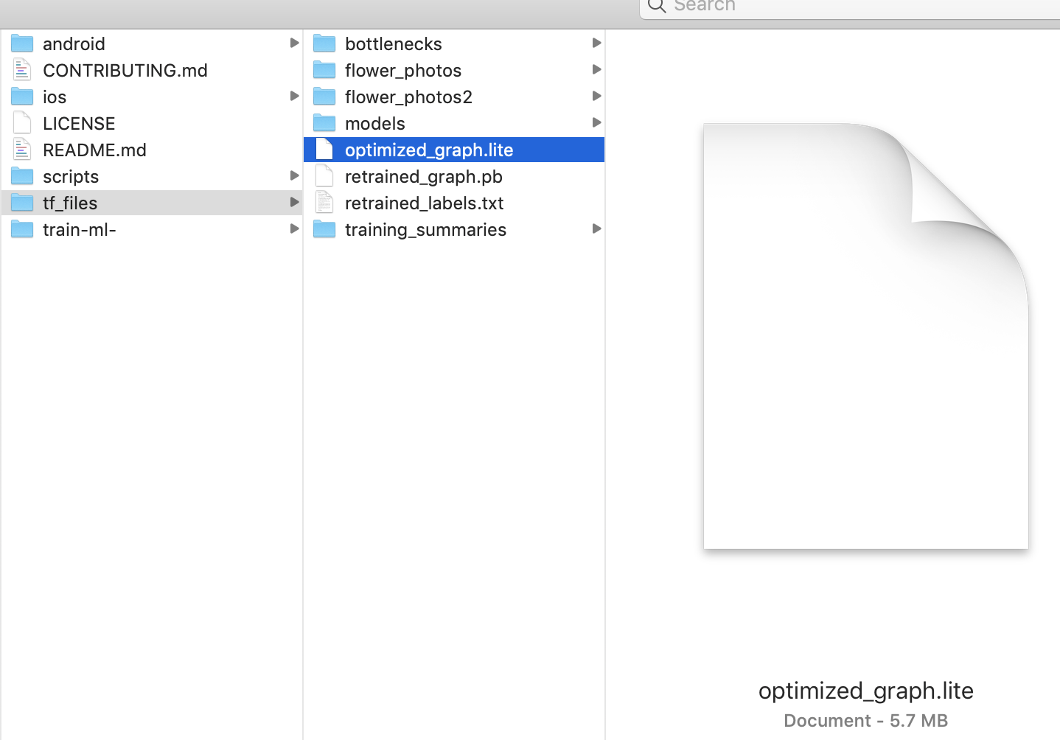
Convert to .lite - Using the TFLite converter
Convert to model to TFLite format
The TensorFlow Lite Converter takes a TensorFlow graph file and creates a graph file used by the TensorFlow Lite interpreter.
IMAGE_SIZE=224 tflite_convert \ --graph_def_file=tf_files/retrained_graph.pb \ --output_file=tf_files/optimized_graph.lite \ --input_format=TENSORFLOW_GRAPHDEF \ --output_format=TFLITE \ --input_shape=1,${IMAGE_SIZE},${IMAGE_SIZE},3 \ --input_array=input \ --output_array=final_result \ --inference_type=FLOAT \ --input_data_type=FLOAT

Slide 25
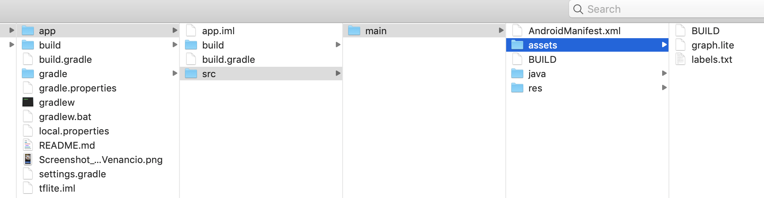
Add your model files to the project
cp tf_files/optimized_graph.lite android/tflite/app/src/main/assets/graph.lite cp tf_files/retrained_labels.txt android/tflite/app/src/main/assets/labels.txt

Slide 26
Android Studio Setup

Slide 27
Setup the Android app
Assumptions-You already setup Android Studio IDE
Import tensorflow-for-poets-2/android/tflite
Build the application

Slide 28
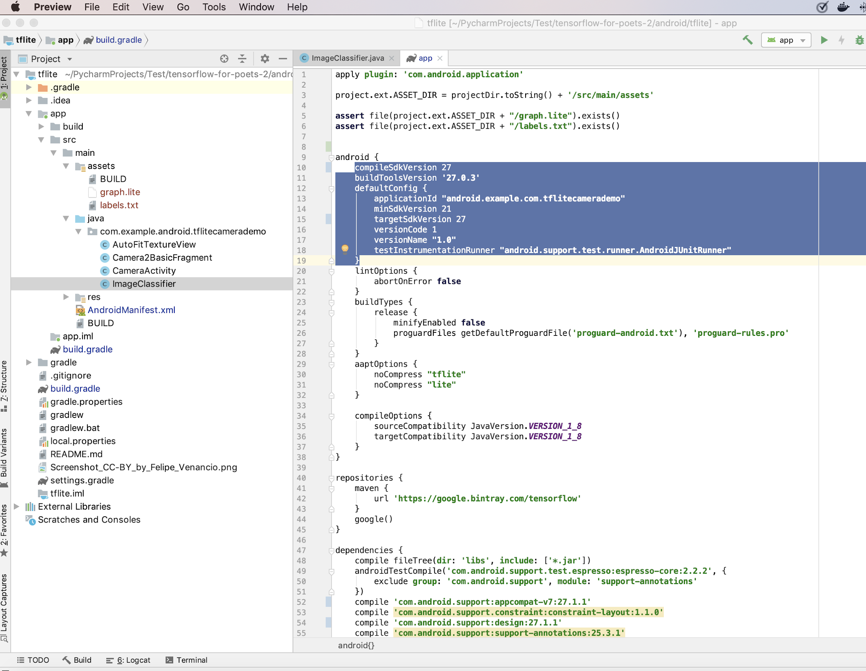
Setup the Android app - change the android tag configuration if required

Slide 29
Test the Android app - Running Machine Learning Models
Connect USB cable on System and Run the app using Android Studio.
This version of the app uses the standard MobileNet, pre-trained on the 1000 ImageNet categories.

Slide 30
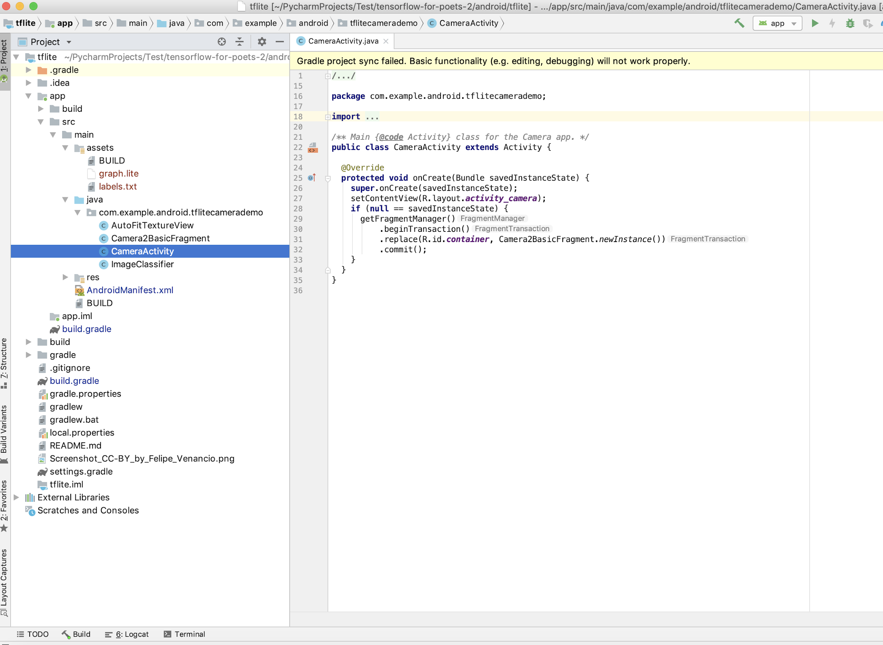
Live Example / Running example with android studio

Slide 31
How does it work - Android Code

Slide 32
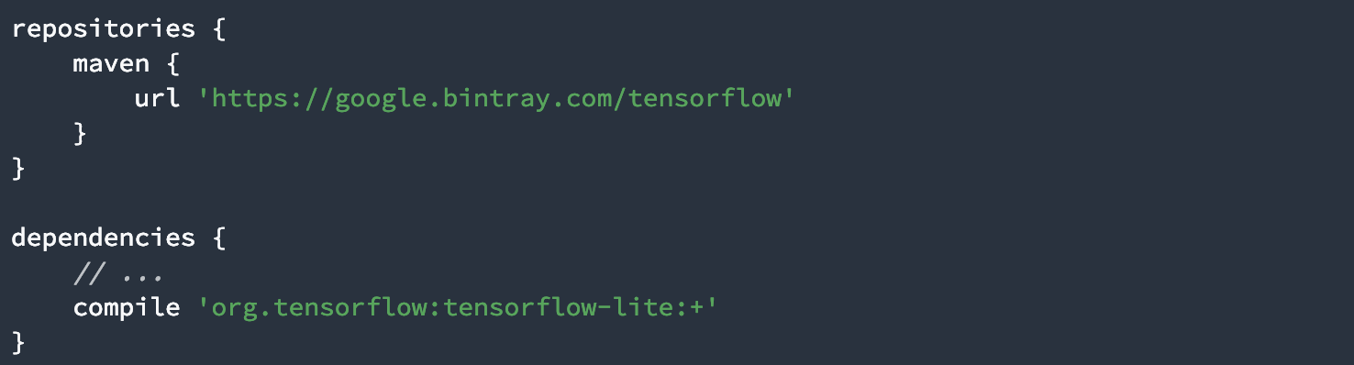
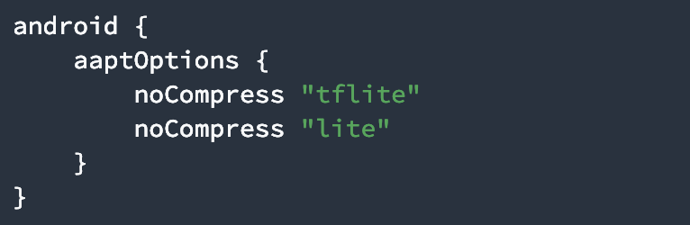
How does it work
This app uses a pre-compiled TFLite Android Archive (AAR).
This AAR is hosted on jcenter.
The following lines in the module's build.gradle file include the newest version of the AAR, from the TensorFlow bintray maven repository, in the
project.build.gradle - see image
We use the following block, to instruct the Android Asset Packaging Tool that .lite or .tflite assets should not be compressed.
This is important as the .lite file will be memory-mapped, and that will not work when the file is compressed.

Slide 33
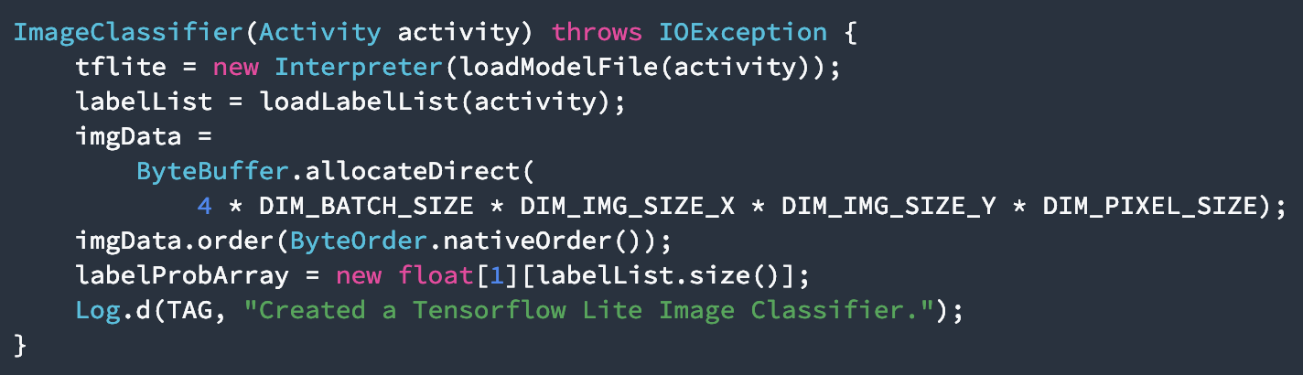
How does it work - Using theTFLite Java API
The code interfacing to the TFLite is all contained in ImageClassifier.java.
The first block of interest is the constructor for the ImageClassifier:
The following line creates the TFLite interpreter:
ImageClassifier.java
This line instantiates a TFLite interpreter.
The interpreter does the job of a tf.Session (for those familiar with TensorFlow, outside of TFLite).
We pass the interpreter a MappedByteBuffer containing the model. The local function loadModelFile creates a MappedByteBuffer containing the activity's graph.lite asset file.

Slide 34
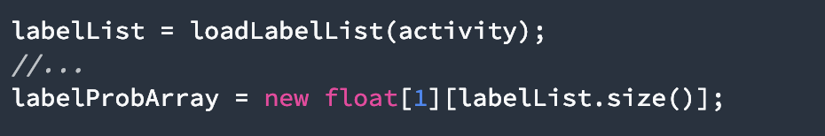
How does it work
The following lines create the input data buffer:
This byte buffer is sized to contain the image data once converted to float.
The interpreter can accept float arrays directly as input, but the ByteBuffer is more efficient as it avoids extra copies in the interpreter.
The following lines load the label list and create the output buffer:
The output buffer is a float array with one element for each label where the model will write the output probabilities.

Slide 35
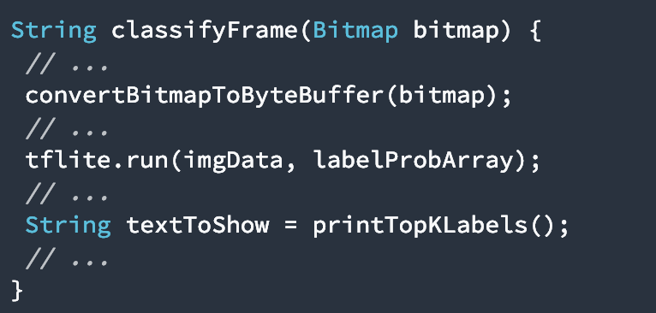
How does it work - Run the model
The second block of interest is the classifyFrame method.
It takes a Bitmap as input, runs the model and returns the text to print in the app.
This method does three things. First converts and copies the input Bitmap to the imgData ByteBuffer for input to the model.
Then it calls the interpreter's run method, passing the input buffer and the output array as arguments.
The interpreter sets the values in the output array to the probability calculated for each class.

Slide 36
https://youtu.be/JnhW5tQ_7Vo
https://www.tensorflow.org/lite
https://www.tensorflow.org/lite/guide/android
https://towardsdatascience.com/machine-learning-classifiers-a5cc4e1b0623
https://towardsdatascience.com/the-7-steps-of-machine-learning-2877d7e5548e
https://www.tensorflow.org/lite/models/object_detection/overview
https://www.youtube.com/channel/UC0rqucBdTuFTjJiefW5t-IQ/playlists
https://github.com/tensorflow/examples/tree/master/lite/examples
References

Slide 37
Questions!

